Slide 1
EEE598 Assignment 0
Anish Vipperla

Slide 2
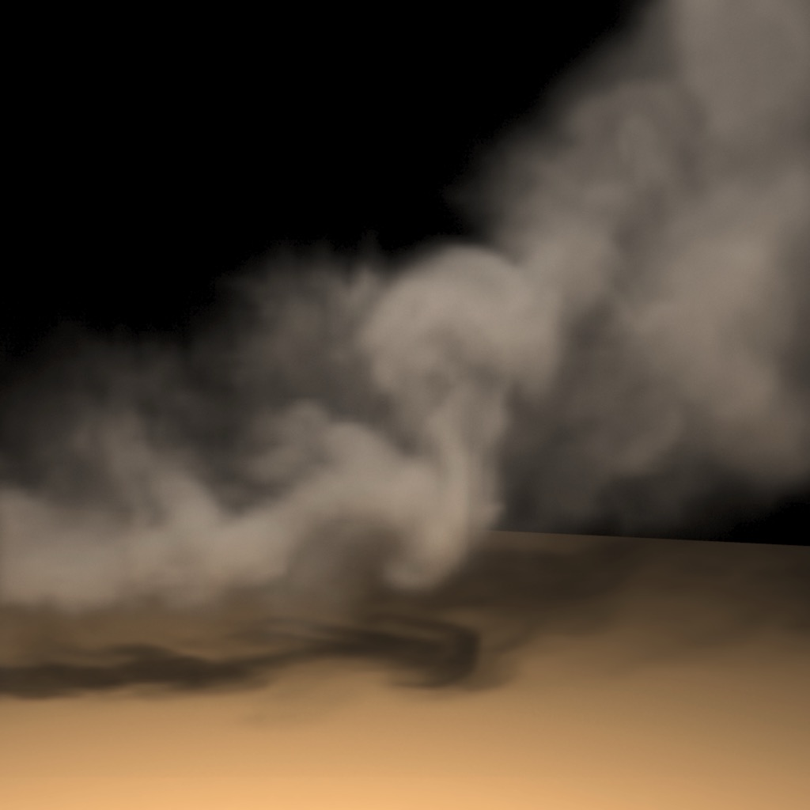
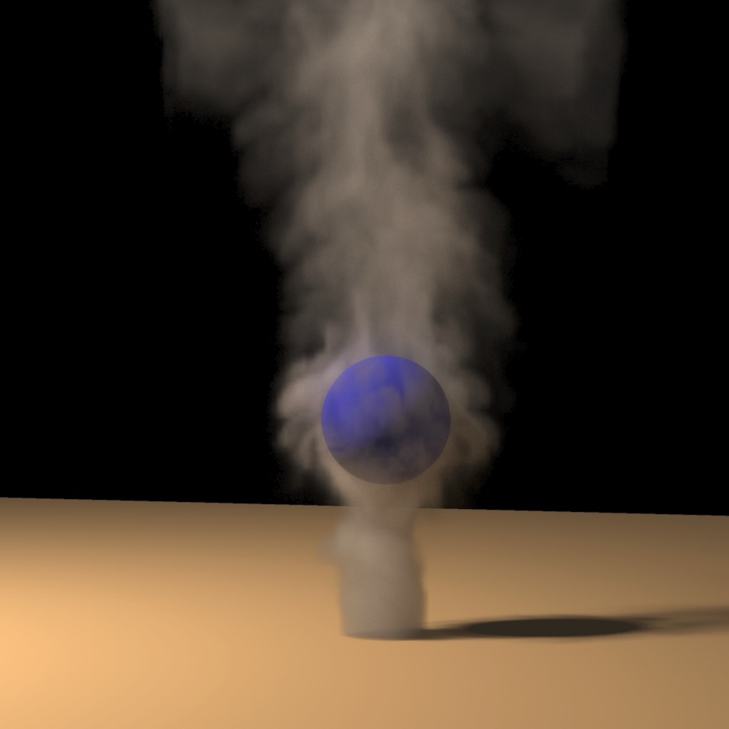
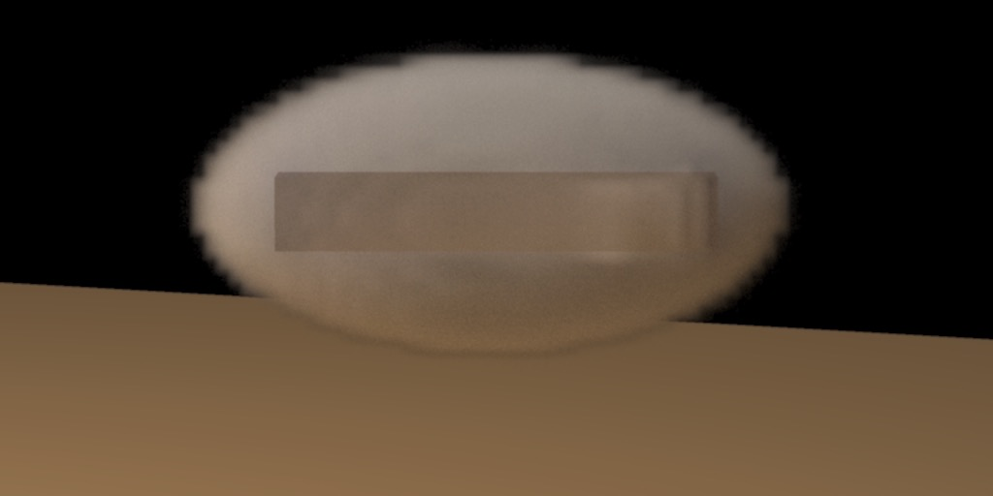
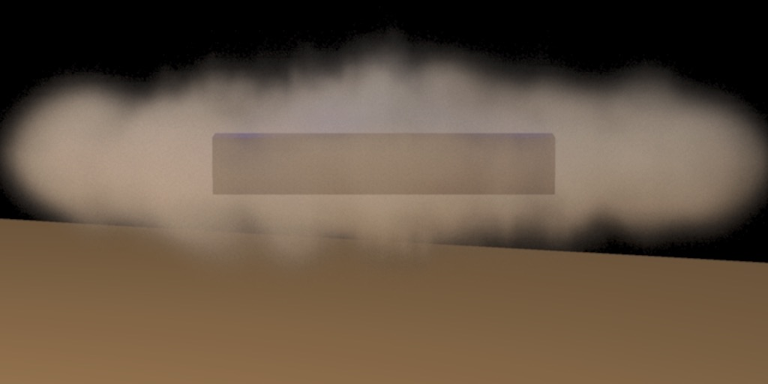
Rendering Smoke
I picked these images [1] because they showcase a significant improvement in rendering of smoke in comparison to prior art. Early works relied solely on using solid textures and animating over time and did not incorporate velocity. Subsequent works modelled the smoke using CFD, however the simulation was coarser due to which the finer details (such as swirling motions) could not be accurately captured. Few works could capture the finer details; however, the simulation wasn’t guaranteed to be stable.
Figures showcase realistic rendering of smoke [1]
CFD: Computational Fluid Dynamics
[1] Ronald Fedkiw, Jos Stam, and Henrik Wann Jensen. 2001. Visual simulation of smoke. In Proceedings of the 28th annual conference on Computer graphics and interactive techniques (SIGGRAPH '01). Association for Computing Machinery, New York, NY, USA, 15–22. https://doi.org/10.1145/383259.383260

Slide 3
Rendering Smoke
[1] was able to address all the prior limitations by incorporating semi-Lagrangian integration scheme to ensure stability, and vorticity confinement for simulating finer movements such as curling, rolling, etc. on a coarser grid. It also showcases object interaction with the smoke by modelling voxels inside, outside, and at the boundary of the object.
Figures showcase realistic rendering of smoke [1]
[1] Ronald Fedkiw, Jos Stam, and Henrik Wann Jensen. 2001. Visual simulation of smoke. In Proceedings of the 28th annual conference on Computer graphics and interactive techniques (SIGGRAPH '01). Association for Computing Machinery, New York, NY, USA, 15–22. https://doi.org/10.1145/383259.383260

Slide 4
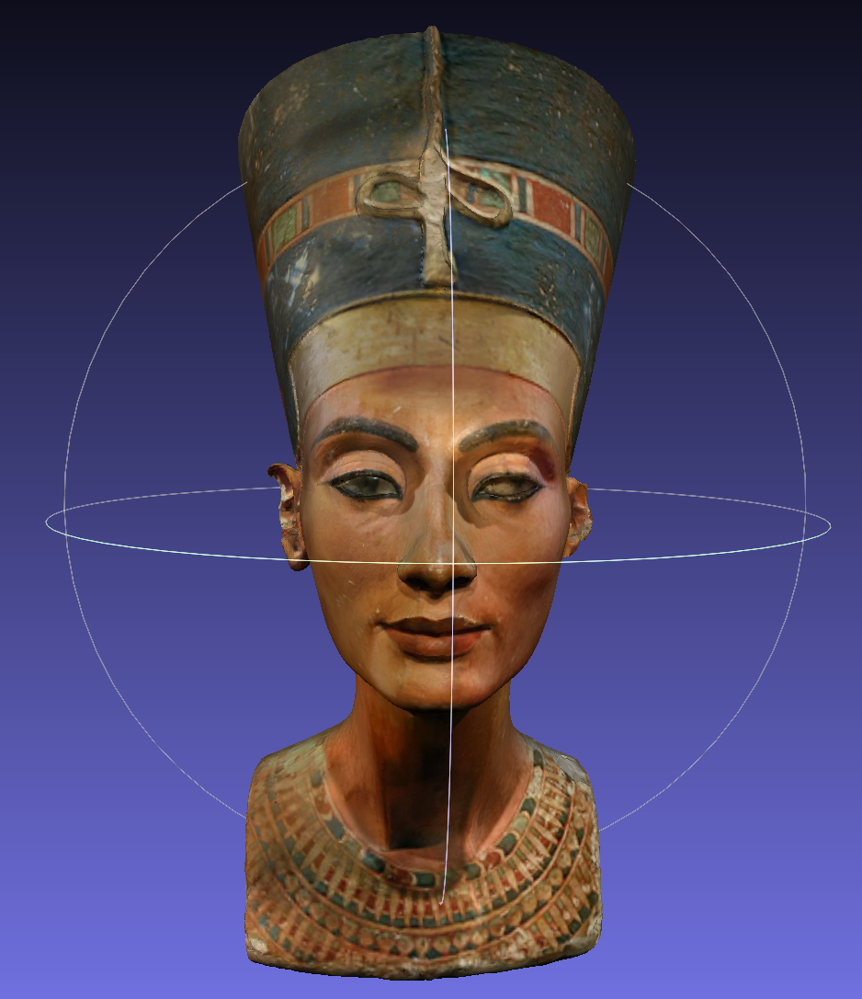
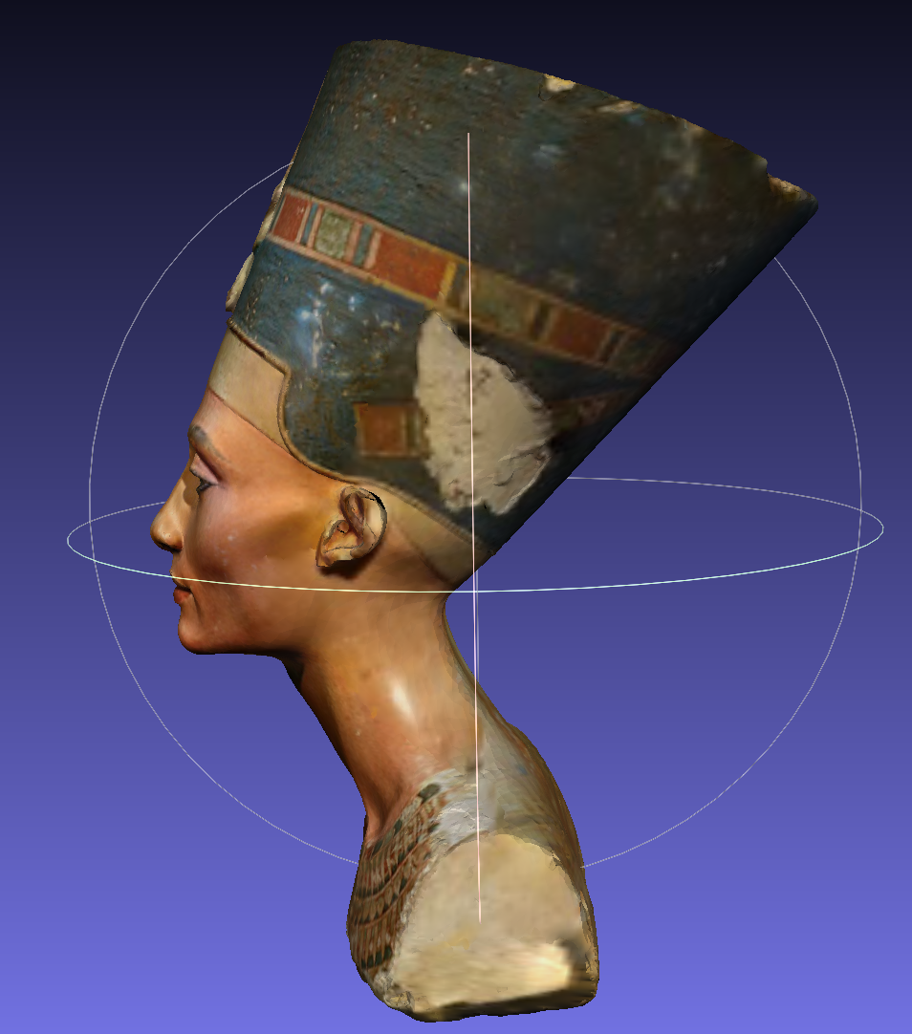
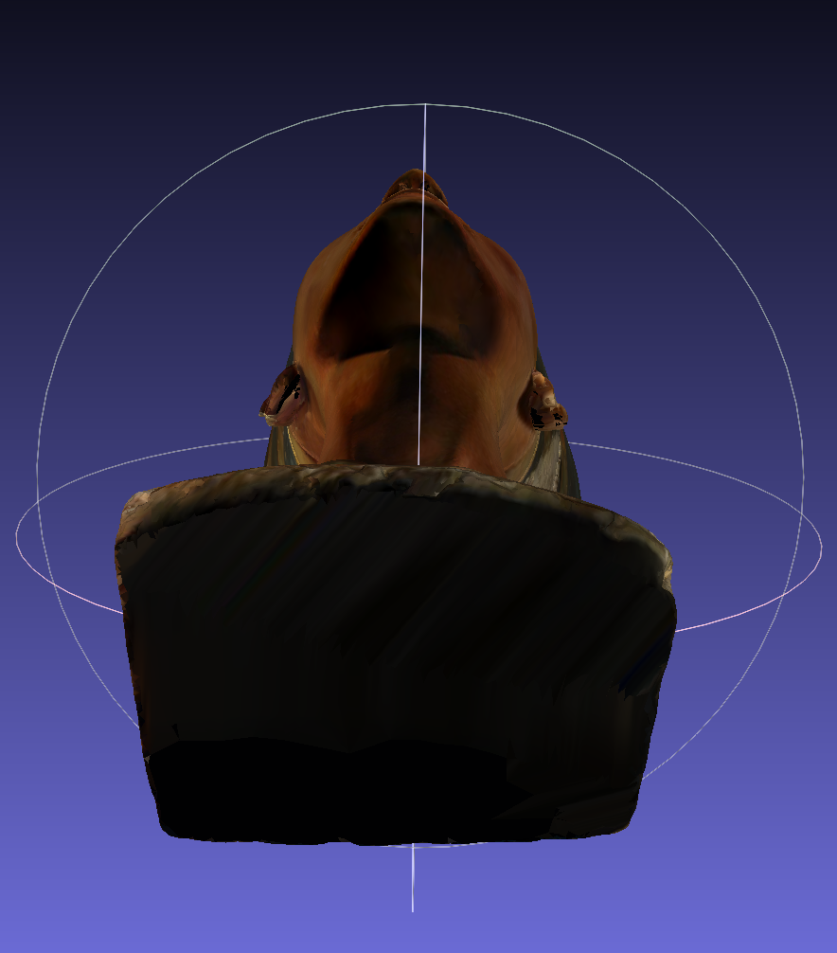
Mesh and Object Visualization in Meshlab
Object Information – 3D model of Nefertiti sculpture
Model credits: C.Yamahata (https://sketchfab.com/3d-models/nefertitis-bust-like-in-the-museum-ce5b14926e494558ab584375a8d63ca7)

Slide 5
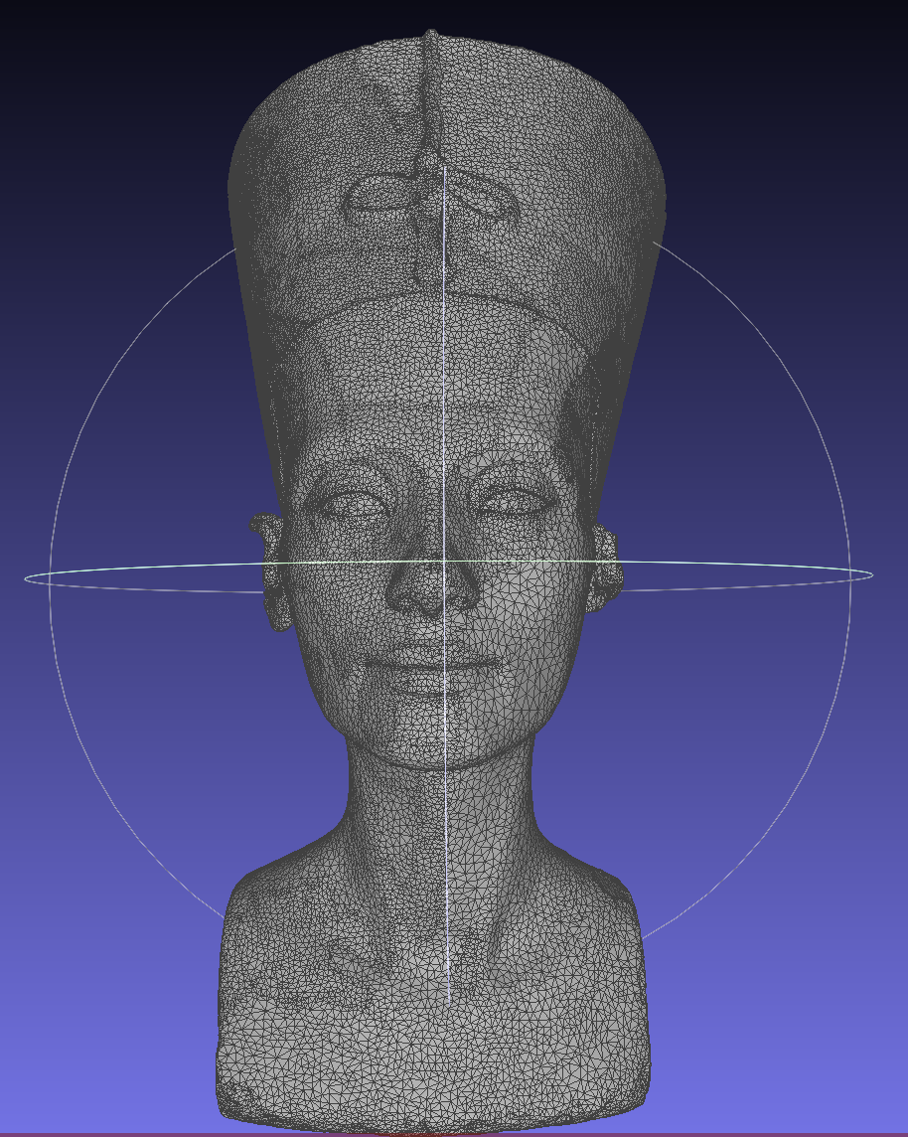
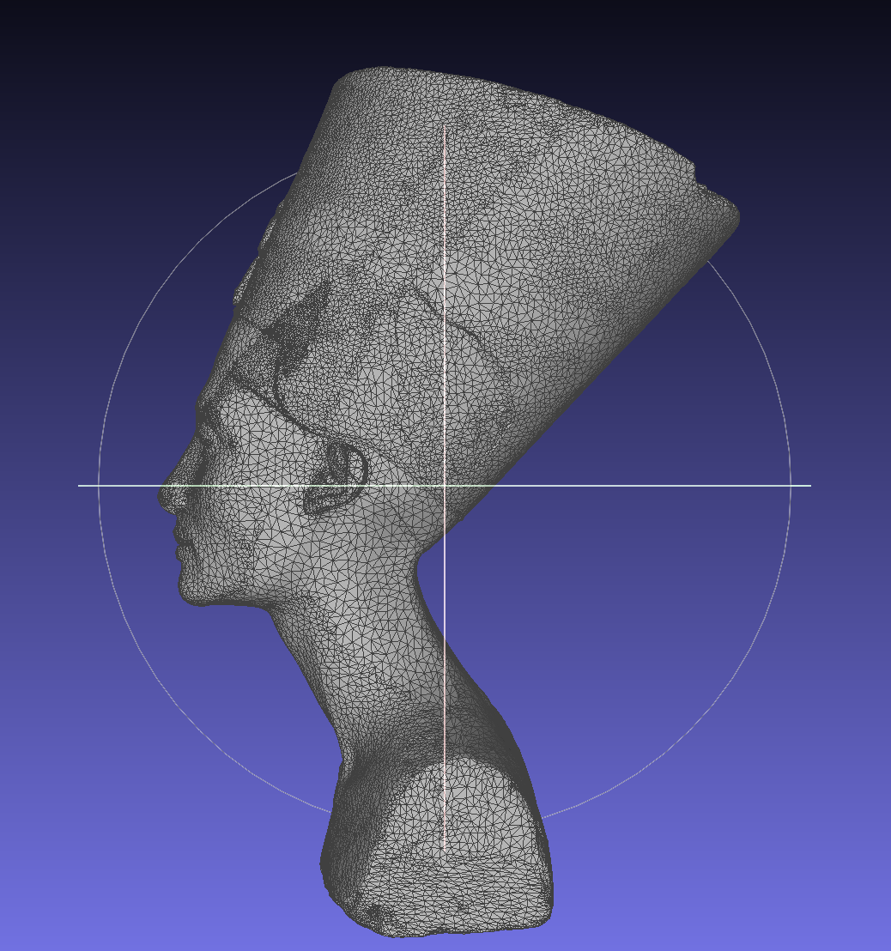
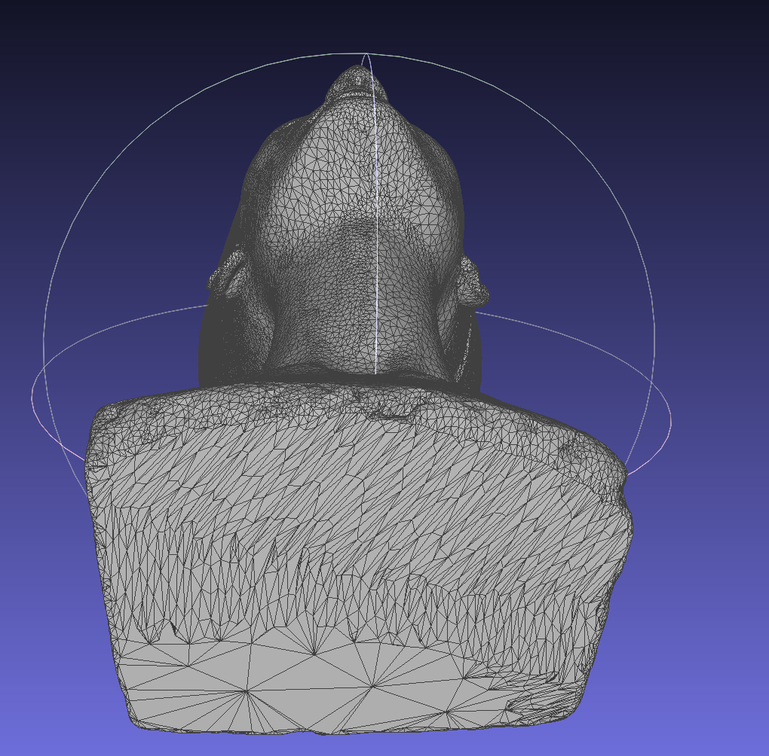
Mesh and Object Visualization in Meshlab
Mesh information – Vertices: 50002, Faces: 100000
Model credits: C.Yamahata (https://sketchfab.com/3d-models/nefertitis-bust-like-in-the-museum-ce5b14926e494558ab584375a8d63ca7)

